Slide 1
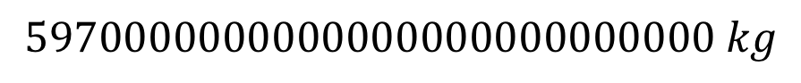
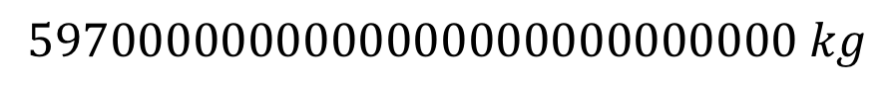
Scientific notation
Scientific notation is a way to express numbers that are very big
Example: the mass of Earth is
$$5970000000000000000000000000 kg$$
That’s hard to write (or even think about). So we count the number of digits after the 1st number:
$$5970000000000000000000000000 kg$$
27 digits
and say $5.97×{10}^{27} kg$. That’s scientific notation.

Slide 2
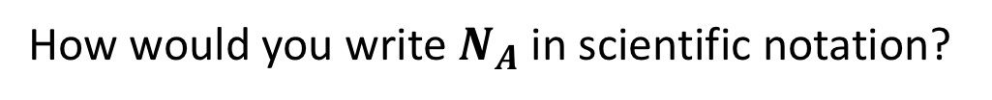
Scientific notation
Another example: There’s a number, called Avogadro’s number, that’s used so much in chemistry that it gets its own symbol, $N_{A}$. Its value is
$$N_{A}=602000000000000000000000$$
23 digits
How would you write $N_{A}$ in scientific notation?

Slide 3
Scientific notation
Another example: There’s a number, called Avogadro’s number, that’s used so much in chemistry that it gets its own symbol, $N_{A}$. Its value is
$$N_{A}=602000000000000000000000$$
23 digits
How would you write $N_{A}$ in scientific notation?
$$N_{A}=6.02×{10}^{23}$$

Slide 4
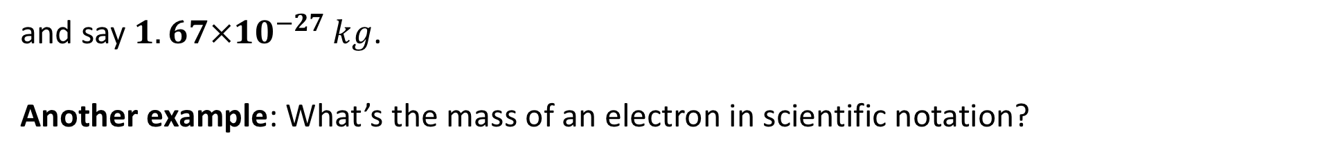
Scientific notation
Scientific notation is also a way to express numbers that are very small
Example: the mass of a proton, in kg, is
$$0.00000000000000000000000000167 kg$$
So we count the number of digits after the decimal point, just past the 1st number:
$$0.00000000000000000000000000167 kg$$
27 digits
and say $1.67×{10}^{−27} kg$.
Another example: What’s the mass of an electron in scientific notation?
$$0.00000000000000000000000000000091$$
31 digits

Slide 5
Scientific notation
Scientific notation is also a way to express numbers that are very small
Example: the mass of a proton, in kg, is
$$0.00000000000000000000000000167 kg$$
So we count the number of digits after the decimal point, just past the 1st number:
$$0.00000000000000000000000000167 kg$$
27 digits
and say $1.67×{10}^{−27} kg$.
Another example: What’s the mass of an electron in scientific notation?
$$0.00000000000000000000000000000091$$
31 digits
Mass of an electron = $9.1×{10}^{−31} kg$

Slide 6
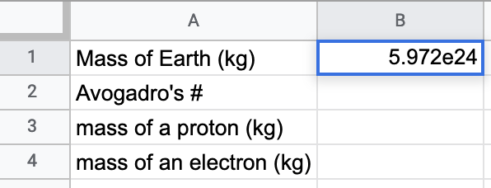
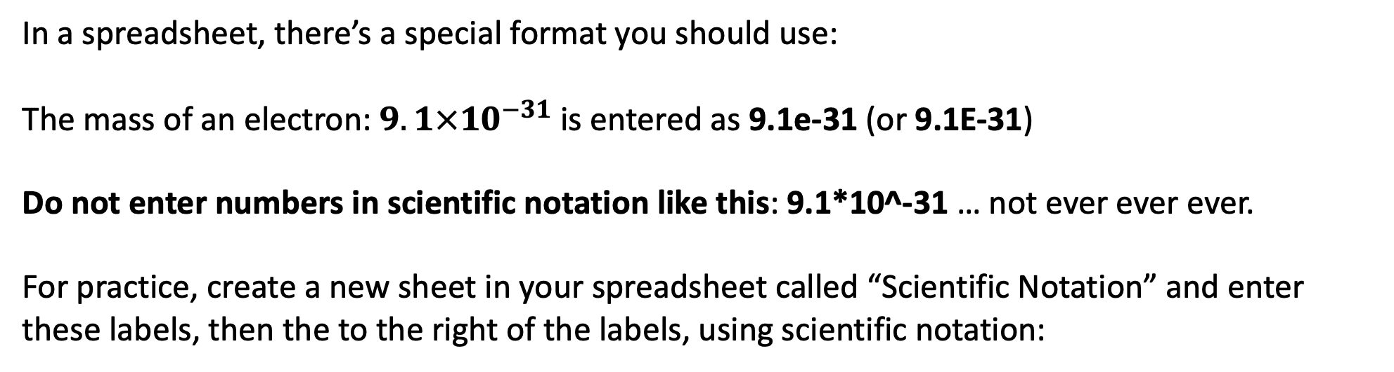
Scientific notation
In a spreadsheet, there’s a special format you should use:
The mass of an electron: $9.1×{10}^{−31}$ is entered as 9.1e-31 (or 9.1E-31)
Do not enter numbers in scientific notation like this: 9.1*10^-31 … not ever ever ever.
For practice, create a new sheet in your spreadsheet called “Scientific Notation” and enter these labels, then the to the right of the labels, using scientific notation:

Slide 7
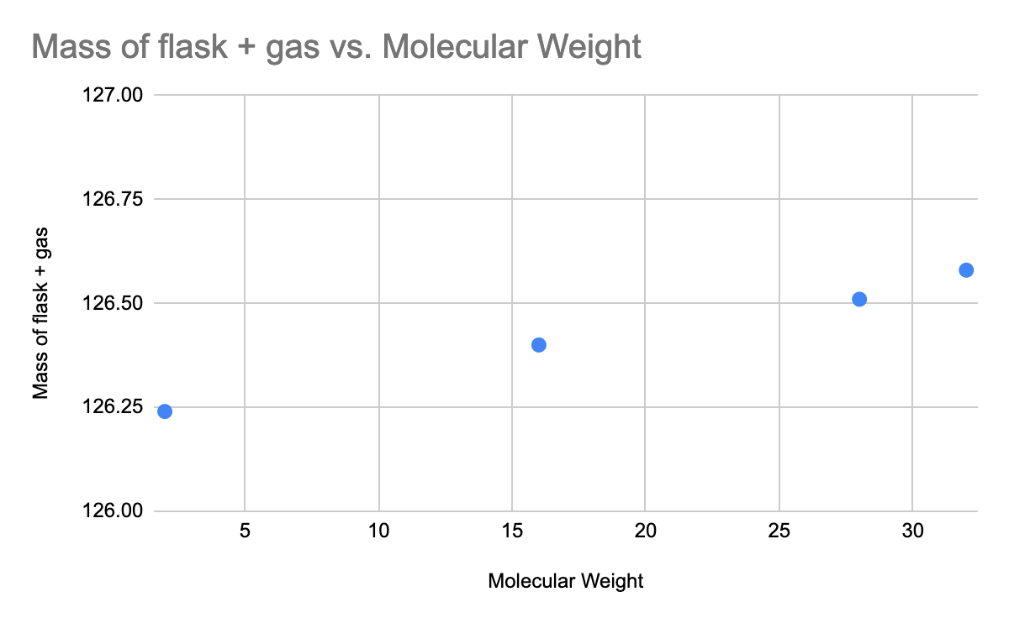
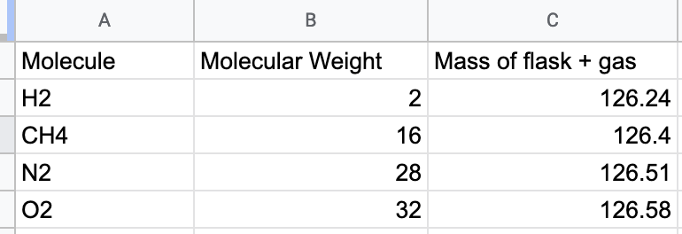
Graphing and line fitting
Say we’ve measured the mass of an Erlenmeyer flask that contains different types of gas, and we want to see what the mass looks like as a function of MW:
We’ll walk through this together …

Slide 8
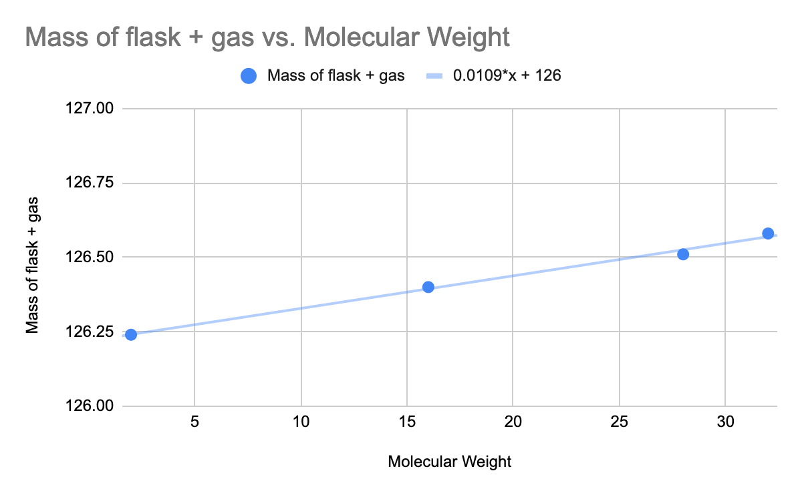
Graphing and line fitting
Say we’ve measured the mass of an Erlenmeyer flask that contains different types of gas, and we want to see what the mass looks like as a function of MW:
See customize … series … trendline … use equation

Slide 9
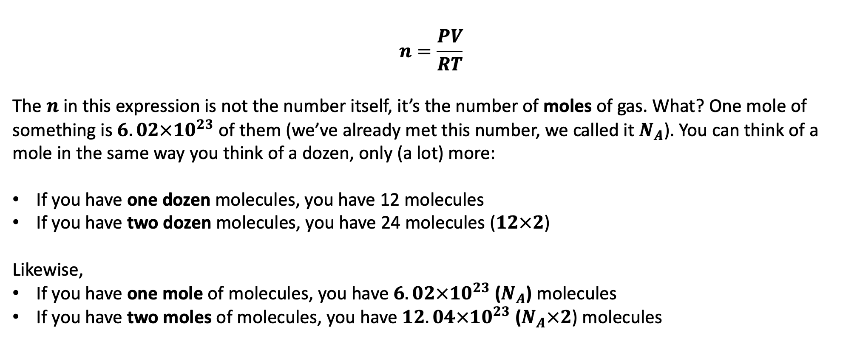
The ideal gas law
$$n=\frac{PV}{RT}$$
The $n$ in this expression is not the number itself, it’s the number of moles of gas. What? One mole of something is $6.02×{10}^{23}$ of them (we’ve already met this number, we called it $N_{A}$). You can think of a mole in the same way you think of a dozen, only (a lot) more:
If you have one dozen molecules, you have 12 molecules
If you have two dozen molecules, you have 24 molecules ($12×2$)
Likewise,
If you have one mole of molecules, you have $6.02×{10}^{23}$ ($N_{A}$) molecules
If you have two moles of molecules, you have $12.04×{10}^{23}$ ($N_{A}×2$) molecules

Slide 10
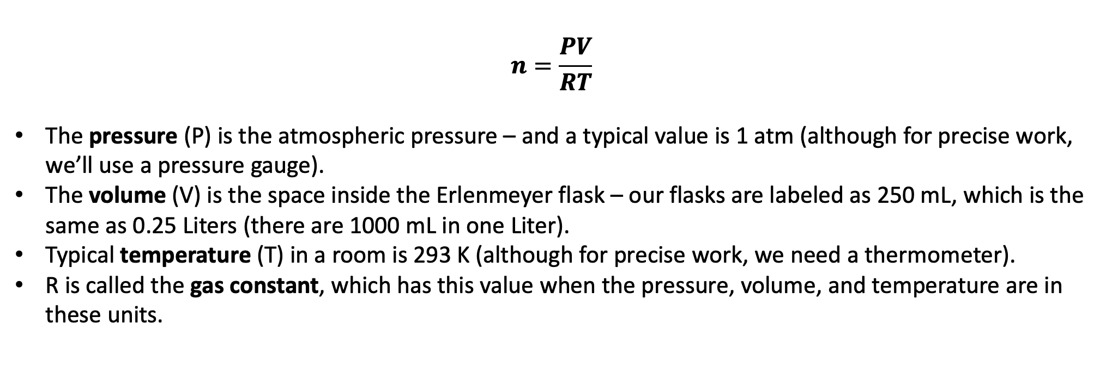
The Ideal gas law
$$n=\frac{PV}{RT}$$
The pressure (P) is the atmospheric pressure – and a typical value is 1 atm (although for precise work, we’ll use a pressure gauge).
The volume (V) is the space inside the Erlenmeyer flask – our flasks are labeled as 250 mL, which is the same as 0.25 Liters (there are 1000 mL in one Liter).
Typical temperature (T) in a room is 293 K (although for precise work, we need a thermometer).
R is called the gas constant, which has this value when the pressure, volume, and temperature are in these units.
Some explanation:
Enter these values into your spreadsheet.

Slide 11
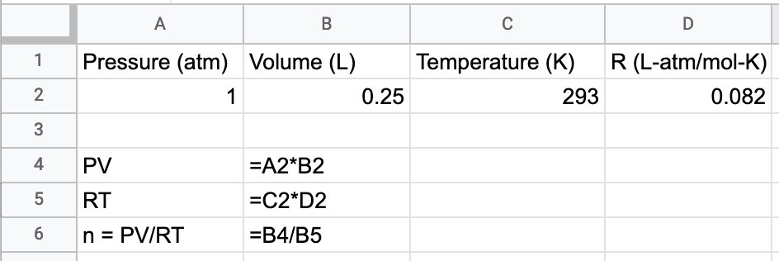

The Ideal gas law
$$n=\frac{PV}{RT}$$
Enter these into a new tab, called “Ideal gas law”
Some explanation:
Enter these values into your spreadsheet.

Slide 12
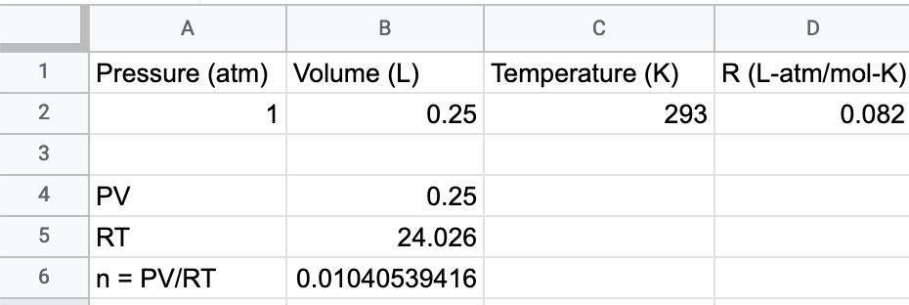
The Ideal gas law
$$n=\frac{PV}{RT}$$
Did you get these values?
Some explanation:
Enter these values into your spreadsheet.

Slide 13
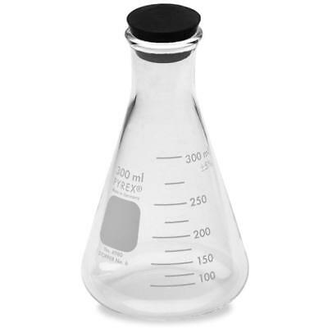
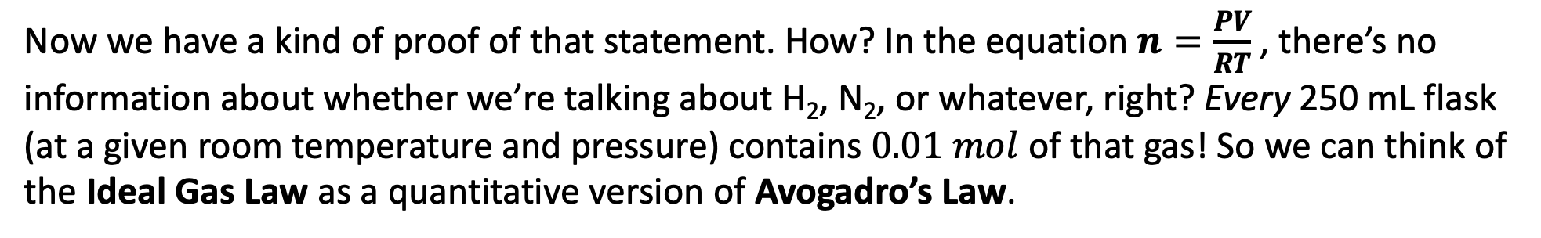
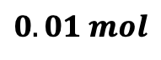
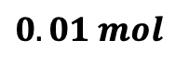
The Ideal Gas Law and Avogadro’s Law
A key connection:
Last week, we said that equal volumes of gas (at the same temperature and pressure) contain the same number of molecules. We called this Avogadro’s Law.
$$0.01 mol$$
$$0.01 mol$$
H₂(g)
N₂(g)
Now we have a kind of proof of that statement. How? In the equation $n=\frac{PV}{RT}$, there’s no information about whether we’re talking about H₂, N₂, or whatever, right? Every 250 mL flask (at a given room temperature and pressure) contains $0.01 mol$ of that gas! So we can think of the Ideal Gas Law as a quantitative version of Avogadro’s Law.

Slide 14

Aside: how much space does an entire mole of gas occupy?
If each 250 mL flask has 1/100th of a mole, to get up to one mole, we’d need …
One mole of gas
100 250—mL flasks will contain 1 mole of gas

Slide 15
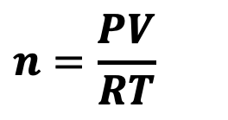
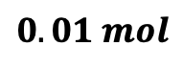
Utility of this idea for identifying an unknown gas
$$n=\frac{PV}{RT}$$
$$0.01 mol$$
Evacuated
Unknown gas
air
If we could figure out how much 0.01 mol of air weighs, then we could figure out how much the evacuated flask weighs (by subtracting the mass of the air). Then, when you get an unknown, you could figure out the mass of the unknown gas!

Slide 16
Utility of this idea for identifying an unknown gas
$$n=\frac{PV}{RT}$$
$$0.01 mol$$
Evacuated
Unknown gas
air
If we could figure out how much 0.01 mol of air weighs, then we could figure out how much the evacuated flask weighs (by subtracting the mass of the air). Then, when you get an unknown, you could figure out the mass of the unknown gas!
To get there, we need to understand the units of what we called Atomic Weight (AW) and Molecular Weight (MW) last week.

Slide 17
The units of “Atomic Weight” and “Molecular Weight”
We said before that the number under the element symbol is the mass of an average atom. To be more careful, we should have said it this way:
AW (of Carbon) = 12.01 amu/atom
where 1 amu is the mass of 1 proton or 1 neutron (approximately).

Slide 18
The units of “Atomic Weight” and “Molecular Weight”
We said before that the number under the element symbol is the mass of an average atom. To be more careful, we should have said it this way:
AW (of Carbon) = 12.01 amu/atom
where 1 amu is the mass of 1 proton or 1 neutron (approximately).
But there’s another way to think about this number …

Slide 19
The units of “Atomic Weight” and “Molecular Weight”
The atomic weight is also the mass of one mole of that atom, in grams. We can say
AW (of Carbon) = 12.01 amu/atom
AW (of Carbon) = 12.01 g/mol

Slide 20

A different interpretation of “Atomic Weight” and “Molecular Weight”
Carbon has
AW =
N₂ has
MW =
O₂ has
MW =
Air (mixture of of N₂ and O₂ has
MW =
1 mole carbon

Slide 21
A different interpretation of “Atomic Weight” and “Molecular Weight”
Carbon has
AW = 12.01 g/mol
N₂ has
MW =
O₂ has
MW =
Air (mixture of of N₂ and O₂ has
MW =
1 mole carbon

Slide 22
A different interpretation of “Atomic Weight” and “Molecular Weight”
Carbon has
AW = 12.01 g/mol
N₂ has
MW = 28.02 g/mol
O₂ has
MW =
Air (mixture of of N₂ and O₂ has
MW =
1 mole carbon

Slide 23
A different interpretation of “Atomic Weight” and “Molecular Weight”
Carbon has
AW = 12.01 g/mol
N₂ has
MW = 28.02 g/mol
O₂ has
MW = 32.00 g/mol
Air (mixture of of N₂ and O₂ has
MW =
1 mole carbon

Slide 24
A different interpretation of “Atomic Weight” and “Molecular Weight”
Carbon has
AW = 12.01 g/mol
N₂ has
MW = 28.02 g/mol
O₂ has
MW = 32.00 g/mol
Air (mixture of of N₂ and O₂ has
MW = 29 g/mol
1 mole carbon

